Slide 1

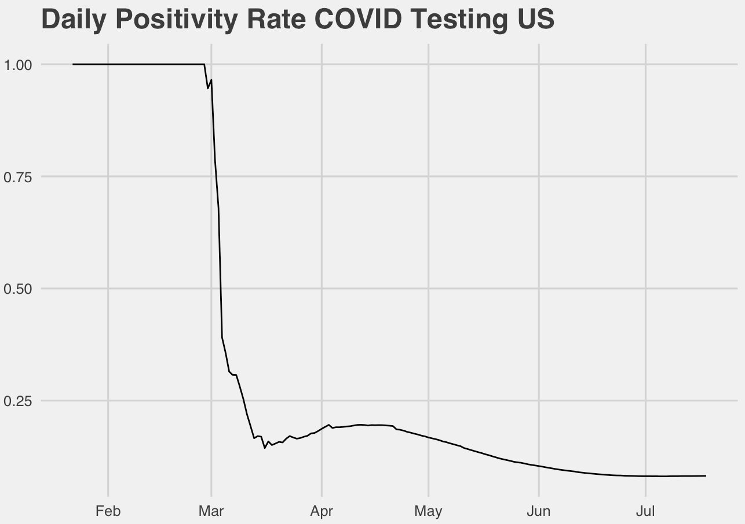
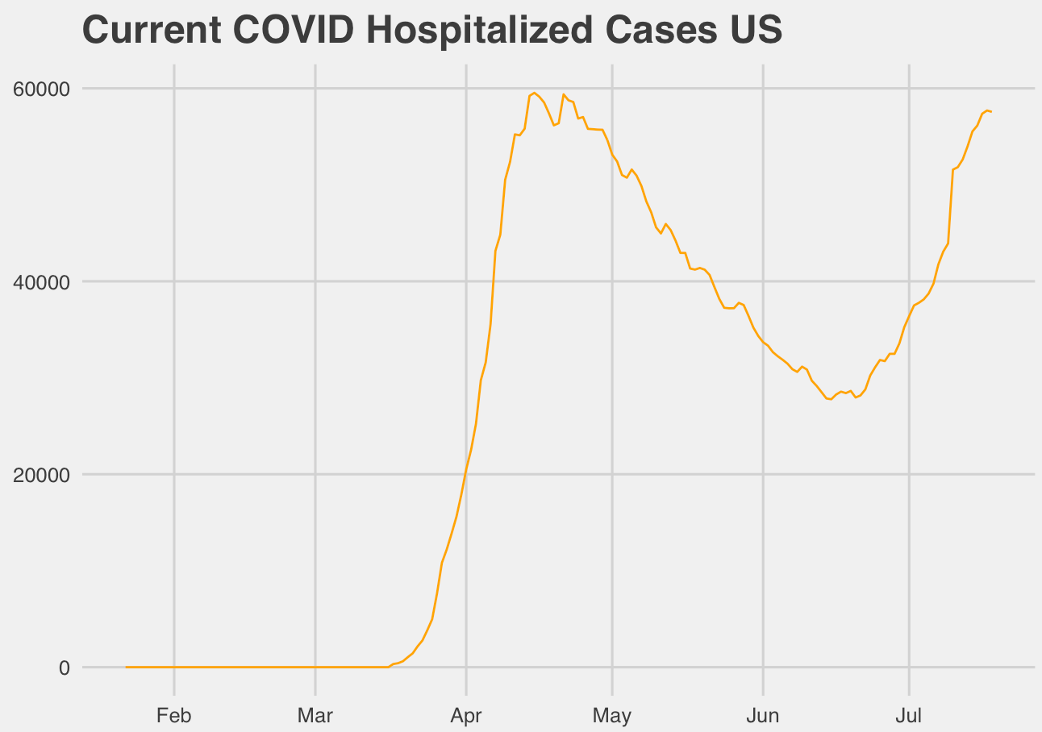

Overview
Presenters
Josh Eysenbach
Jaclyn Coate
Data Set
The COVID Tracking Project
California data: ca.gov
Severity Measurement
Positive Percent
Death Rate
Currently Hospitalized
Notes:
Josh 30 sec
As a reminder for where we left off, our data comes from the COVID Tracking Project, and the metric we decided to analyze is the number of COVID-related patients currently in the hospital. We spoke briefly about how this data can’t be considered stationary, but how stationary models could still possibly be useful for long-term forecasting where we have high uncertainty. We discussed a few of our univariate time-series models and ended with talking about our intent to try and improve our models with a multivariate analysis. We also wanted to see if we could make any useful conclusions about what variables like New cases can tell us about hospitalizations going forward.

